Slide 1
Starting we with gti

Slide 2
pre we
Downloading necessary applications
Vs code(sorry Andy)
SQL Server Express
.NET core
VPN access
Hello World webapp
To check it all works

Slide 3
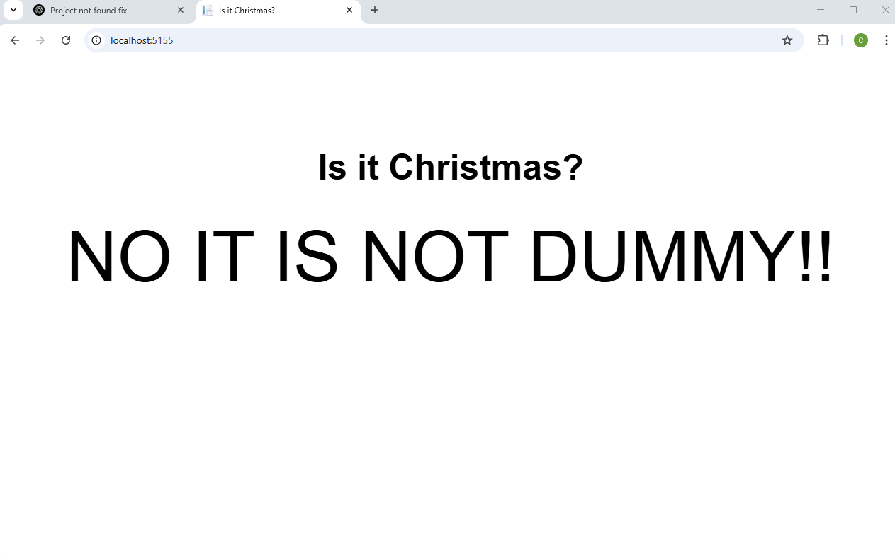
monday

Slide 4
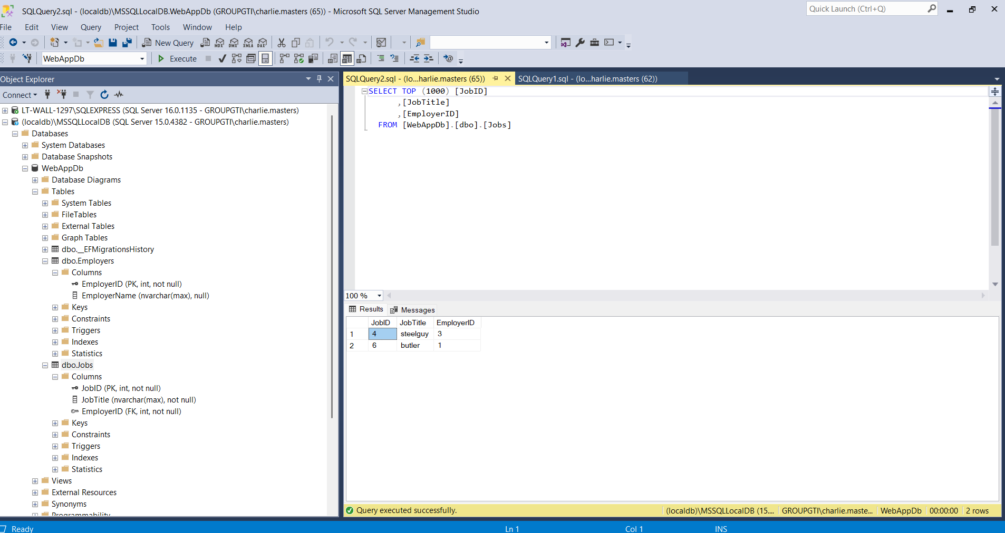
Tuesday

Slide 5
Tuesday/Wednesday/Thursday/Friday
The entity test project

Slide 6
Friday
Learn git
Make GitHub account
Upload entitytest project to GitHub
https://github.com/fyroluck/entitytest.git

